Slide 1



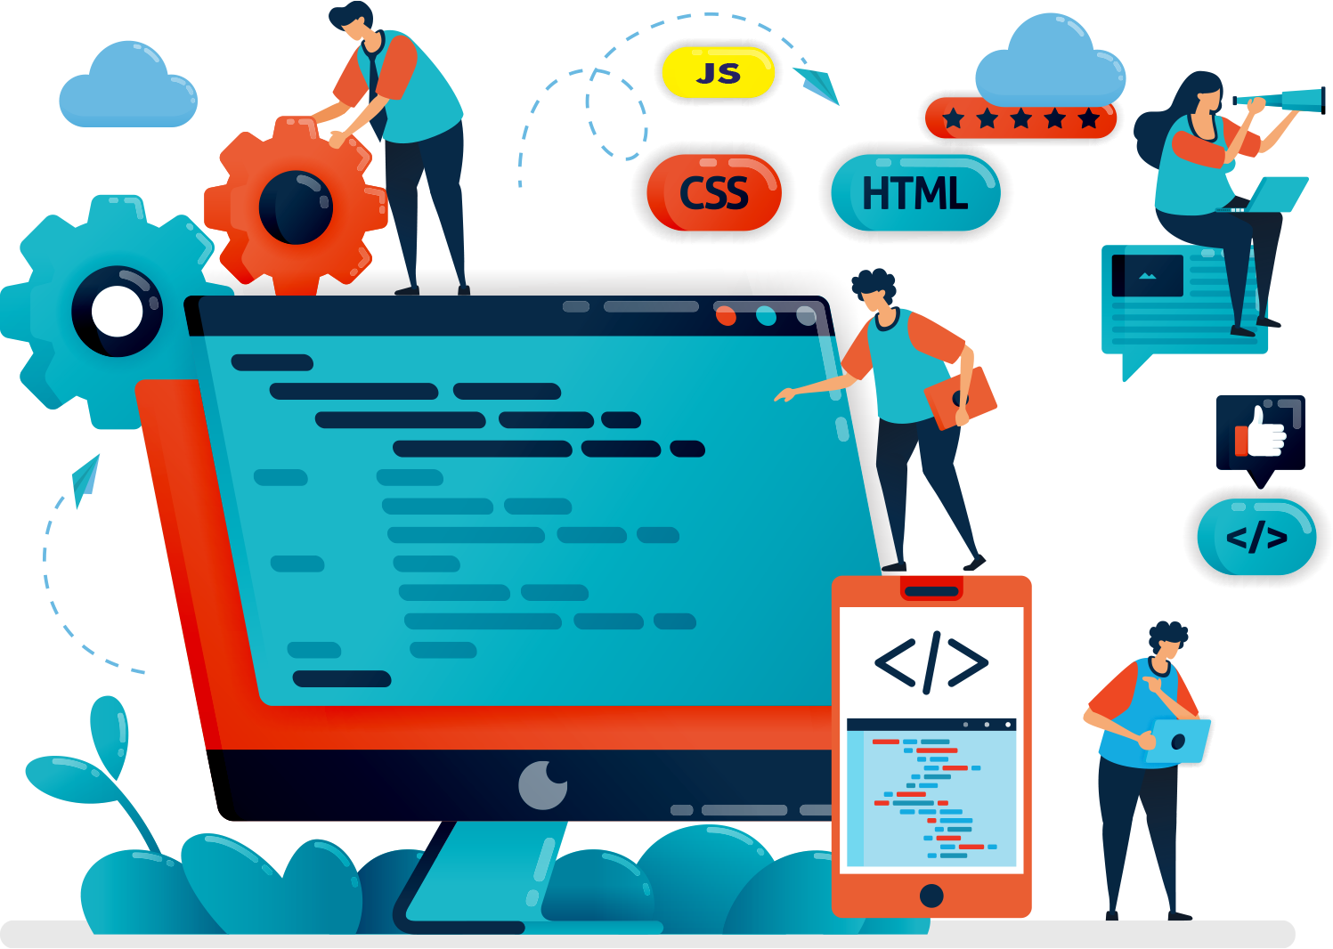

Welcome to the Web Development Boot Camp
Learn to Code the easy way

Slide 2


ABOUT ME
EMMANUEL BASK-AIYEDUN
ELECTRICAL AND ELECTRONICS ENGINEERING MAJOR
VICE CHAIR – IEEE SOCIETY, AUN

Slide 3
AGENDA
Intro to the Web
Intro to Web Development
Careers in Web Development
HTML Tutorial
CSS Tutorial
JavaScript Tutorial
Your very own project

Slide 4
INTRO TO THE WEB
What is the Web?
The web is an interconnected system of public web pages accessible through the internet.

Slide 5
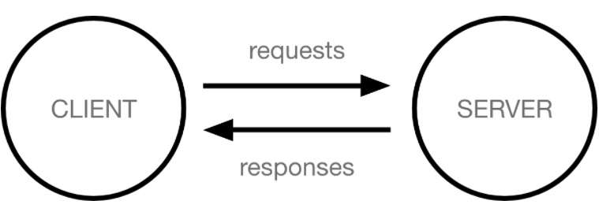
INTRO TO THE WEB
How the web works

Slide 6
INTRO TO WEB DEV.
What is Web Development?
Web development is the process of creating, building and maintaining websites and webpages for the web and the internet as a whole

Slide 7
INTRO TO WEB DEV.
Classification of Web Development
Front-End Development
Back-End Development
Full-Stack Development

Slide 8
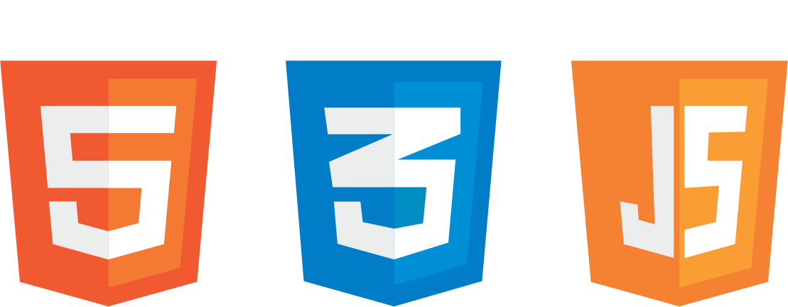
INTRO TO WEB DEV.
What is HTML, CSS and JavaScript?
HTML – Skeleton of the Web Page
CSS – Skin and Body of the Web Page
JavaScript – Brain of the Web Page
HTML
CSS
JavaScript

Slide 9
CAREERS IN WEB DEV.
There are many career options in the Web Development industry however, the following are the major ones:
Web Designer
Front-End Developer
Back-End Developer
Full-Stack Developer
Content Developer
Web Master

Slide 10
HTML TUTORIAL
AGENDA
Intro to HTML and HTML Tags
Lists, Paragraphs and Text Styling
Displaying Data with Tables
HTML Forms, Images and Iframe
Inline CSS
HTML 5

Slide 11
HTML TUTORIAL
HTML 5 SEMANTICS
Header
Nav
Section
Main
Aside
Article
Footer

Slide 12
CSS Tutorial
Cascading Style Sheet
CSS
Skin and Body of the Web Page

Slide 13
ABOUT ME
ABUBAKAR A. NUHU
SOFTWARE ENGINEERING MAJOR
MEMBER – IEEE SOCIETY, AUN

Slide 14
CSS TUTORIAL
What is CSS
Methods For Adding CSS
CSS Selectors
Colors in CSS
Class and Id
Box Model

Slide 15
What is CSS
Cascading Style Sheets is a style sheet language used for describing the presentation of a document written in a markup language such as HTML.

Slide 16
What is CSS
CSS, or Cascading Style Sheets, tell the browser how to display the text and other content that you write in HTML. With CSS, you can control the color, font, size, spacing, and many other aspects of HTML elements.

Slide 17
What is CSS
Note:
CSS is NOT a programming language; it is a stylesheet or styling language used for website layout and design.
CSS does not have logic

Slide 18
Types of CSS
There are 3 methods of adding CSS to and HTML file:
Inline CSS: it is a method of adding style Directly in the HTML element
Internal CSS: is a method of adding style by using <style> tag within same document.
External CSS: is a method of adding style by linking an external .css file

Slide 19
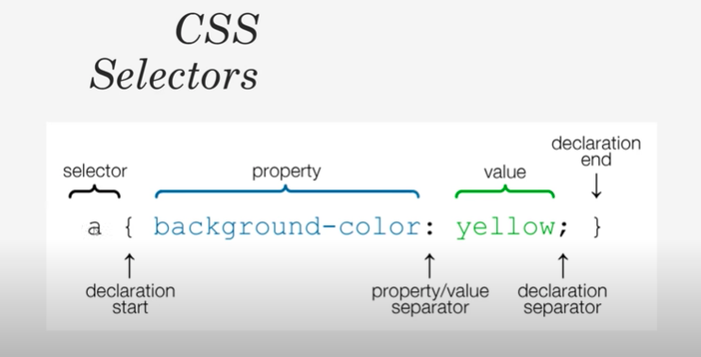

Slide 20
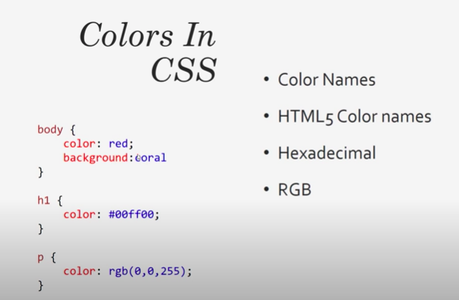

Slide 21
Class and Id
Use a class when you want to consistently style multiple elements throughout the page/site. Classes are useful when you have, or possibly will have in the future, more than one element that shares the same style.
Use the ID when you have a single element on the page that will take the style.

Slide 22
Class and Id
Difference between id and class attribute:
The only difference between them is that “id” is unique in a page and can only apply to at most one element, while “class” selector can apply to multiple elements.

Slide 23
Class and Id
In Html for an element ID name starts with the “#” symbol followed by a unique name assigned to it. On the other hand class assigned to an element has its name starts with “.” followed by class name.

Slide 24
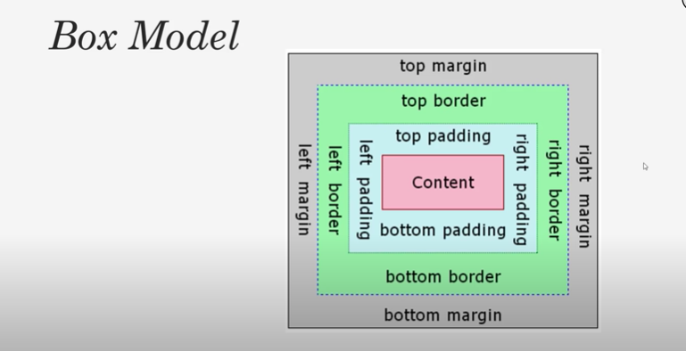

Slide 25
Link States
Hover
Active
Visited

Slide 26
THANKS FOR COMING
SEE YOU ALL NEXT WEEK

